Slide 1
STORY 4
File created on: 10/31/2023 9:13:36 AM

Slide 2
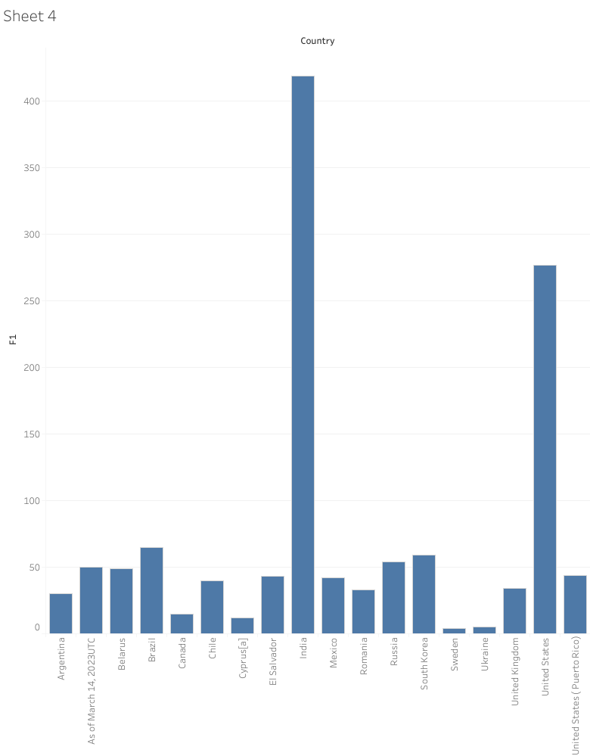

Slide 3
